Slide 1

5 Creative Ways to Integrate Official Languages on a Sport Organization Budget
Cinq moyens créatifs d’intégrer les langues officielles au budget d’un organisme de sport

Slide 2

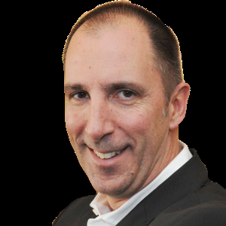
Martin Boileau
Martin Boileau was named Director General of Sport Canada at the Department of Canadian Heritage in July 2009 in preparation for the Vancouver Games in 2010.
Before his appointment to this position, Mr. Boileau served as Director General of Communications from January 2006 to July 2009 and as Corporate Secretary at Canadian Heritage from September 2002 to January 2006.
He enjoys various sports including cycling, running, alpine skiing and water-skiing.
Welcome / Bienvenue

Slide 3
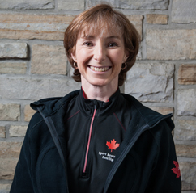
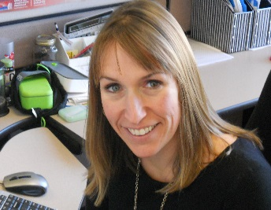
Speakers / Présentateurs
Debra Gassewitz
Jaimie Earley
For over 15 years, Debra has grown SIRC into the world's most highly respected international sport research centre. She has led SIRC's evolution from "Library" to "Knowledge Broker” developing strategic marketing opportunities and leveraging new technologies to create innovative multi-media learning tools and communication vehicles that have significantly enhanced SIRC's business and benefited individuals and organizations at all levels of sport.
Jaimie is the Manager of Sport Canada’s Official Languages Unit.
Since joining Sport Canada in 2007, Jaimie has held various positions within the Organization including Senior Program officer and Chief of Staff to the Director General. Prior to joining Sport Canada, she worked as Synchro Canada’s High Performance Manager overseeing Synchro Canada’s National team programs.

Slide 4
Webinar Overview / Aperçu du webinaire
Today’s webinar will address:
  Greetings & Welcomes
  Terminology
  Translation
  Funding
  Social Media
* Look for the asterisk! This means that there are additional resources to follow.

Slide 5
Greetings & Welcomes /
Salutations et accueil
  In-person Greetings
  Telephone Reception
  Meetings
  Email & Voicemail

Slide 6
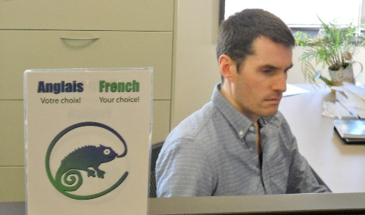
In-person Greetings
Greet in both official languages and continue the conversation in the official language chosen by the person.
Identify bilingual employees.
Consider staffing reception area with a bilingual employee.
Keep a list of bilingual employees at hand.
Create a bilingual atmosphere.
Ensure signage indicating that both official languages are spoken is visible. *
Source : Making your organization bilingual – Canadian Heritage

Slide 7
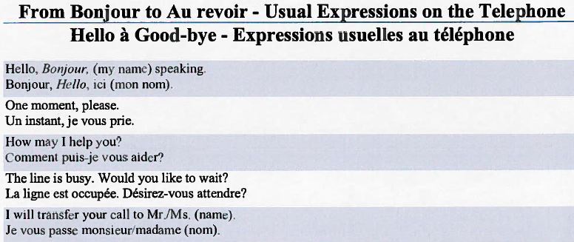
Telephone Reception
Answer in both official languages
Keep a "cheat sheet" by the telephone. *
Identify bilingual person(s) within your organization.
Ensure that voicemail messages are recorded in both official languages.
If your organization does not have a receptionist or is unable to staff this position with a bilingual employee consider letting calls ring into a bilingual voice mail.
Source : Making your organization bilingual – Canadian Heritage

Slide 8
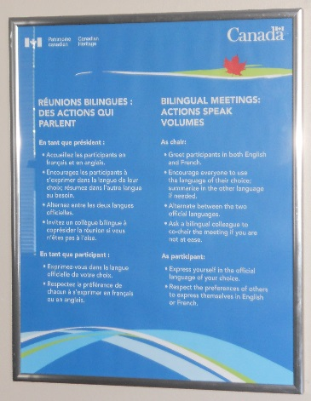

Slide 9
Bilingual Meetings – 10 Tips
  Send a bilingual invitation.
  Share all material simultaneously in English and French.
  Remember that the presence of some unilingual participants does not prevent bilingual meetings.
  Ask a bilingual colleague to lead the meeting if you cannot chair in your second language.
  Open with a bilingual greeting.
  Announce at the beginning of the meeting that all participants can use the official language of their choice.
  Provide on-going summaries if needed and alternate between English and French throughout the meeting.
  Invite participants to ask for clarification when needed.
  Treat all ideas equally, whether voiced in English or French.
  Ask for feedback on how the bilingual meeting went.
Source: Treasury Board of Canada Secretariat website

Slide 10
Email & Voicemail
  Email
  i. Signature Bloc *
  ii. Out-of-office Employee *
  2) Voicemail
    Regular Message *
    Short-term Absence *

Slide 11

Email Signature Samples
Bloc de signature / Signature Bloc
Nom de l’employé / Employee’s name
Titre du poste | Position title
Direction | Division
Sport Canada
Ministère du Patrimoine canadien | Department of Canadian Heritage
15, rue Eddy, 16e étage | 15 Eddy Street, 16th floor
Gatineau (Québec), K1A 0M5 | Gatineau, Quebec, K1A 0M5
adresse courriel / email address
Téléphone | Telephone : XX
Télécopieur | Facsimile : XX
Téléimprimeur (sans frais) | Teletypewriter (toll-free) : 1-888-997-3123
Gouvernement du Canada | Government of Canada
Catherine Gosselin-Després
Executive Director, Sport | Directrice exécutive, sport
Canadian Paralympic Committee | Comité paralympique canadien
310-225 rue Metcalfe Street | Ottawa, Ontario | Canada K2P 1P9
tel / tél 613.569.4333 x241 | cell / cel 613.371.2420 | fax / téléc 613.569.2777
CGosselin-Despres@paralympic.ca| www.paralympic.ca | www.paralympique.ca
Ian Moss
Chief Executive Officer/Chef de la Direction
Speed Skating Canada – Patinage de vitesse Canada
850 Industrial Ave., Suite 17F
Ottawa, ON, K1G 4K2
Tel/Tél: 613-260-3669 x 102
Cell: 613-791-7479
Fax: 613-260-3660
Email/Courriel: imoss@speedskating.ca
“The Relentless Pursuit of Excellence / À la conquête de l’excellence”

Slide 12
Voicemail Samples
Boîte vocale – messages réguliers / Voicemail – Regular Messages
Option 1
Bonjour, ici votre nom. Veuillez laisser un message au timbre sonore ou composer le numéro de téléphone d’un collègue pour parler à nom du collègue. Merci.
Hello, this is your name. Please leave a message after the tone or dial a co-worker’s phone number to speak to co-worker’s name. Thank you.
Option 2
Bonjour. Vous avez joint nom de l’Unité XX. Je suis au bureau mais présentement dans l'impossibilité de prendre votre appel. Veuillez me laisser un message détaillé et je vous rappellerai dès que possible. Merci.
Hello. This is name in the XX Unit. I am in the office; however I am currently away from my desk. Please leave me a detailed message and I'll return your call as soon as possible. Thank you for calling.

Slide 13
Questions & Poll / Questions et sondage

Slide 14

Terminology / Terminologie

Slide 15
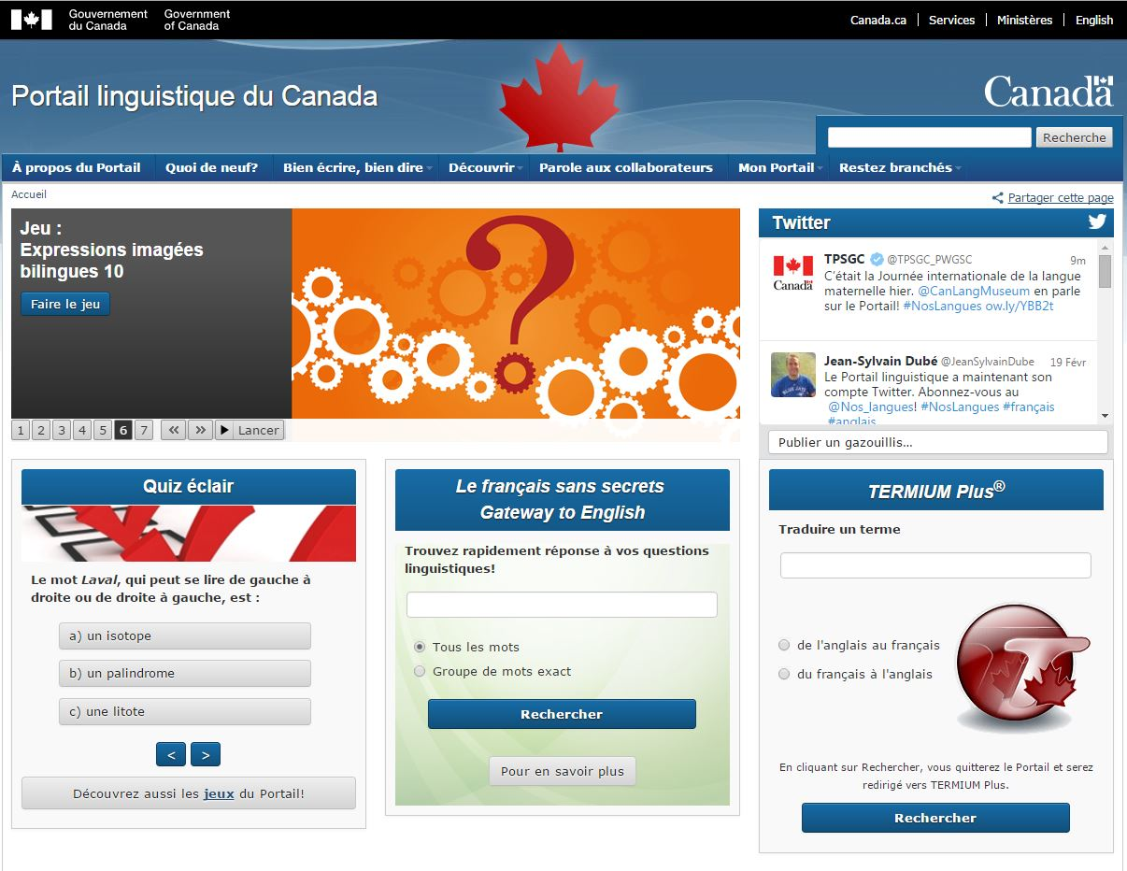
Terminology / Terminologie
Terminology and Linguistic Data Banks*
Language Portal of Canada
http://www.noslangues-ourlanguages.gc.ca/index-eng.php

Slide 16
Sport Lexicons *
Sport Canada Glossary - http://publications.gc.ca/site/eng/9.582437/publication.html
Summer Sports Glossaries:
  Olympic and Paralympic Summer Sports Glossary (London 2012) - http://www.lexique-jo.org/2012/index1.html
  Olympic and Paralympic Summer Sports Glossary (Beijing 2008) - http://www.lexique-jo.org/beijin/
  Pan-African Glossary of Sports (2005) - http://publications.gc.ca/site/eng/9.674413/publication.html
  Soccer Glossary - http://www.btb.termiumplus.gc.ca/tpv2alpha/alpha-eng.html?lang=eng&srchtxt=&i=1&index=alt&codom2nd=1&page=publications/soccer-eng
Winter Sports Glossaries:
  Glossary of Paralympic Winter Sports (Vancouver 2010) - http://publications.gc.ca/site/eng/9.583879/publication.html

Slide 17
Guides
  Writing Tools
    Guide de rédaction et de style en français - http://communications.pch.gc.ca/guides/style_f.cfm
    English Writing and Style Guide - http://communications.pch.gc.ca/guides/style_e.cfm
  Promoting Official Languages
    Organizing a Major Sporting Event in Canada: A Practical Guide to Promoting Official Languages – (Office of the Commissioner of Official Languages) - http://www.ocol-clo.gc.ca/html/guide_032011_e.php
    The Practical Guide to the Official Languages of the Olympic Games: A Planning Tool for Organizing Committees – (International Organization of La Francophonie) - http://www.francophonie.org/IMG/pdf/OIFGuide_UK_BD.pdf
    Making our organization bilingual - http://www.pch.gc.ca/special/guide/index-eng.cfm
  Beyond Bilingual Meetings: Leadership Behaviours for Managers - http://www.ocol-clo.gc.ca/html/stu_etu_032011_e.php

Slide 18
Questions & Poll / Questions et sondage

Slide 19
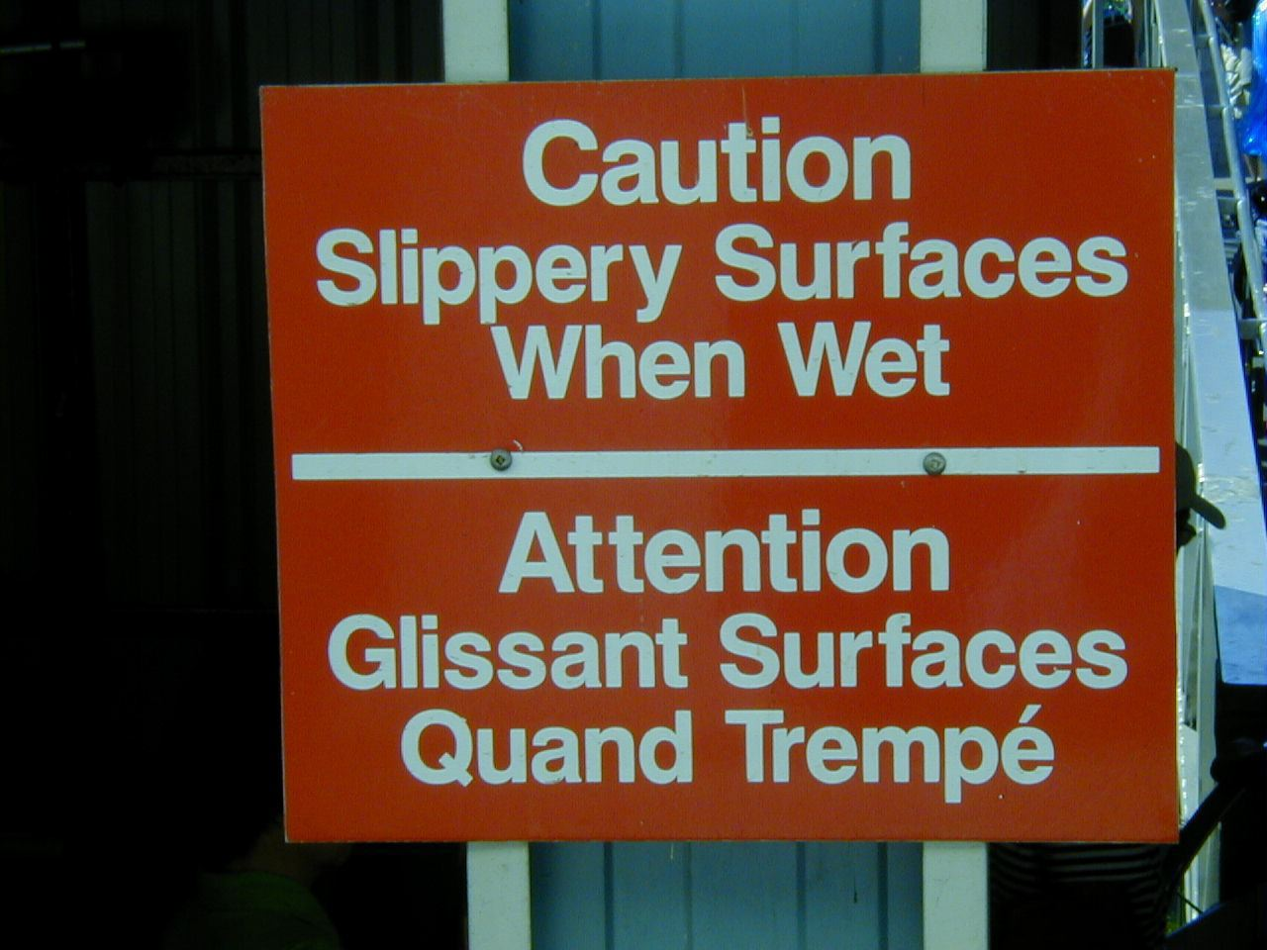
Translation / Traduction
Translation
Example – French to English
Example – English to French
Cost Considerations
2) Interpretation
Cost Considerations

Slide 20
1) Translation
Example – French to English
Original | Google Translate | Professional Translation
Débutant le plongeon en 1996, Jennifer Abel perce la scène internationale en 2006 en participant à son premier Grand Prix international et en remportant une médaille de bronze au 3 m lors des Championnats du monde juniors. En 2007, aux Championnats panaméricains juniors, la Lavalloise gagne notamment l'or au 3 m et au 3 m synchro avec Meaghan Benfeito. Source : Diving Plongeon Canada website | Beginner diving in 1996, Jennifer Abel drilled internationally in 2006 by participating in his first international Grand Prix and winning a bronze medal in the 3 m at the Junior World Championships. In 2007, the Pan American Junior Championships, including of Laval won gold in the 3m and 3m synchro with Meaghan Benfeito. | Jennifer Abel started diving in 1996, at the age of five. She broke onto the international scene at her first Grand Prix ten years later, and won a bronze medal on the 3M at the World Junior Championships in the same year. In 2007 the Laval native earned gold medals on the 3M and the 3M synchro with Meaghan Benfeito at the Pan American Junior Championships. Source : Diving Plongeon Canada website

Slide 21
Example – English to French
Original | Google Translate | Professional Translation
Freestyle - Slopestyle This newest discipline to the world cup circuit has gained huge popularity in the past few years. Riders compete individually on a course containing a variety of large jumps, terrain features and rails. They are expected to flow smoothly from start to finish without stopping and the judges look for similar criteria as they do in the halfpipe. Source : The Canadian Freestyle Ski Association website | Freestyle - Slopestyle Cette nouvelle discipline pour le circuit de la Coupe du monde a gagné une énorme popularité au cours des dernières années. Les cyclistes se disputent individuellement sur un cours contenant une variété de grands sauts, des caractéristiques physiques et des rails. Ils sont censés couler en douceur du début à la fin sans arrêt et les juges recherchent des critères similaires comme ils le font dans la demi-lune. | Style libre - Slopestyle Cette discipline fait son entrée sur le circuit de la Coupe du monde cette saison. Elle a fait de nombreux adeptes au cours des dernières années. L’épreuve se déroule sur un parcours au terrain changeant et sur lequel se trouvent de grosses bosses et des rampes. Les planchistes doivent négocier successivement tous les obstacles sans s’arrêter. Les critères sur lesquels les juges fondent leur évaluation sont les mêmes que pour l’épreuve de demi-lune. Source : The Canadian Freestyle Ski Association website

Slide 22
Translation / Traduction
Cost considerations
  Consider using a contract outlining rates, services, deadlines and/or special considerations (Sample contracts; Model Translation Contract). *
  Plan in advance giving as much notice as possible.
  Avoid last minute requests which may incur “rush” charges.
  Have someone internal review the translation to ensure that the translator, who is not part of your organization’s culture, has captured the essence of the document.
  Consider contacting a local school of translation. Students may be available for small translation jobs as part of their study program. * http://www.noslangues-ourlanguages.gc.ca/index-eng.php
  Source: Making your organization bilingual – Canadian Heritage

Slide 23
Interpretation / Interprétation
Cost Considerations
Get more than one quote.
Plan in advance. With good planning in terms of equipment, rooms and events, you may be able to use a single interpretation team.
Determine in advance language needs of your participants.
Evaluate what parts, if not all, of the event requires interpretation.
Two interpreters are usually enough for each half day.
Rent only the equipment you need.
Seek out rental locations that have permanent interpretation booths to save on equipment rental costs.
Plan your event so that all parts requiring interpretation are held in the same room.
Have background material available for the interpreter(s) in advance for their review.
Contact a local school of translation and interpretation. There may be students who are available to do smaller scale interpretation as part of their study program. Canadian Association of Schools of Translation - Member Programs * http://www.uottawa.ca/associations/acet/prog_membr.htm#Programmes
  Source: Making your organization bilingual – Canadian Heritage

Slide 24
PCH Funding / Financement PCH
Support for Interpretation and Translation sub-component
The Support for Interpretation and Translation sub-component aims to assist organizations to encourage participation at public events in both official languages and to increase the number of documents available in both official languages.
Support: Project grant funding which may not exceed 50% of eligible expenses up to a maximum of $5,000 per application.
Deadlines: Continuous intake process. Applications must be received a minimum of 3 months prior to the project start date.

Slide 25
Support for Interpretation and Translation sub-component (Cont’d)
Eligible projects:
Events: Simultaneous interpretation and translation of documents from one official language to the other related to the delivery of public events held in Canada.
Translation: Translation, from one official language to the other, of documents intended for members of the organization and the Canadian public such as website content, promotional material and reports.
Eligible recipients: Canadian non-profit organizations that are officially registered and incorporated. Individuals, government organizations, universities, schools, and hospitals are not eligible.
http://www.pch.gc.ca/eng/1267548087384/1254192746896

Slide 26
Questions & Poll / Questions et sondage

Slide 27
Social Media / Médias sociaux
How does a sport organization integrate Official Languages into their social media to meet the SFAF performance measure?

Slide 28
Level 1 – Initiating
The organization develops a strategy for its communications via social media.
  Bilingual or separate equivalent unilingual versions in both official languages.
  Separate unilingual versions should provide equally rewarding experience.
  Separate unilingual versions should indicate availability of the alternate official language.
  When a bilingual version is produced, the title of the page (name of the organization) must be bilingual when the account is created.
Level 2 – Emerging
The organization has a strategy implemented for its communications via social media.

Slide 29
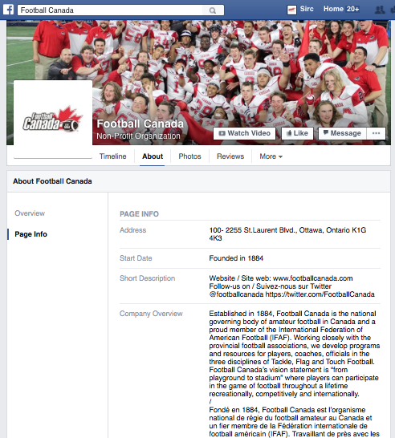
Level 3 – Developing
The static content (e.g. organization profile, conditions of use, contact info, etc.) has equivalent content and equal language quality in both official languages.
Example : Facebook page of Football Canada
https://www.facebook.com/FootballCanada/info/?tab=page_info

Slide 30
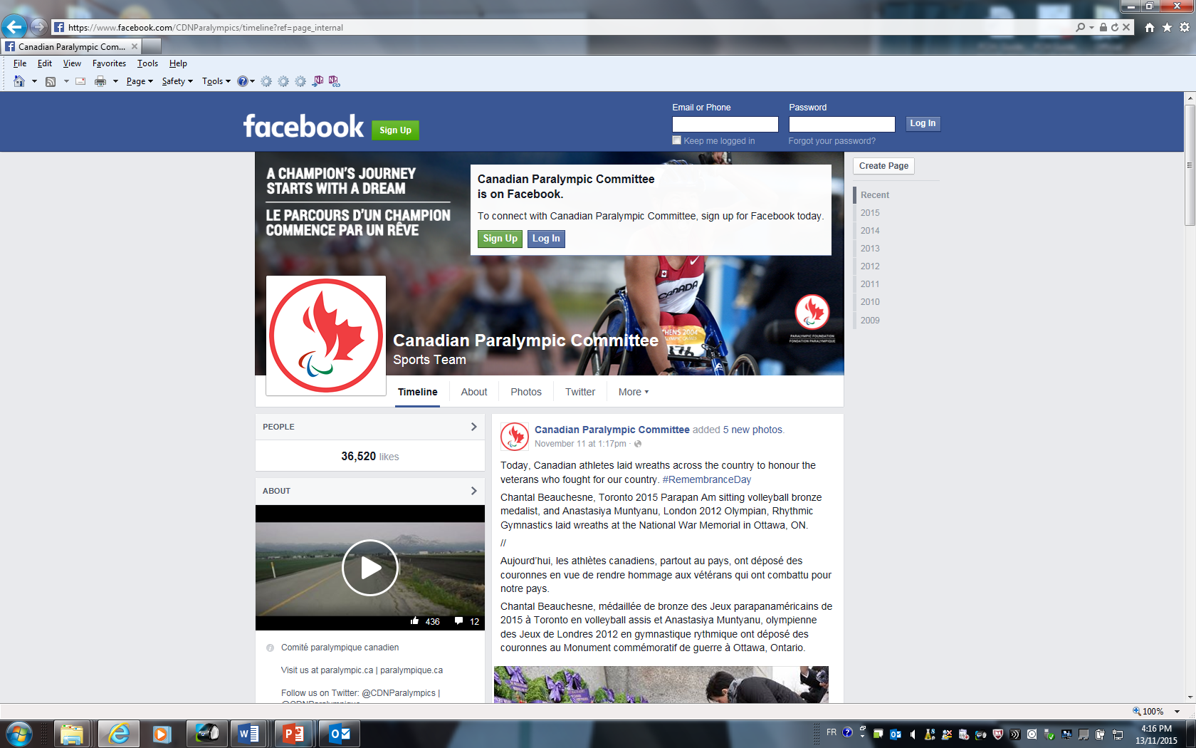
Level 4 - Implementing
The communication from the organization have equivalent content and equal language quality in both official languages.
  General interest info must be available in both official languages.
  Questions and comments are answered in the language of submission.
  Example : Facebook page of the Canadian Paralympic Committee
https://www.facebook.com/CDNParalympics/timeline?ref=page_internal

Slide 31
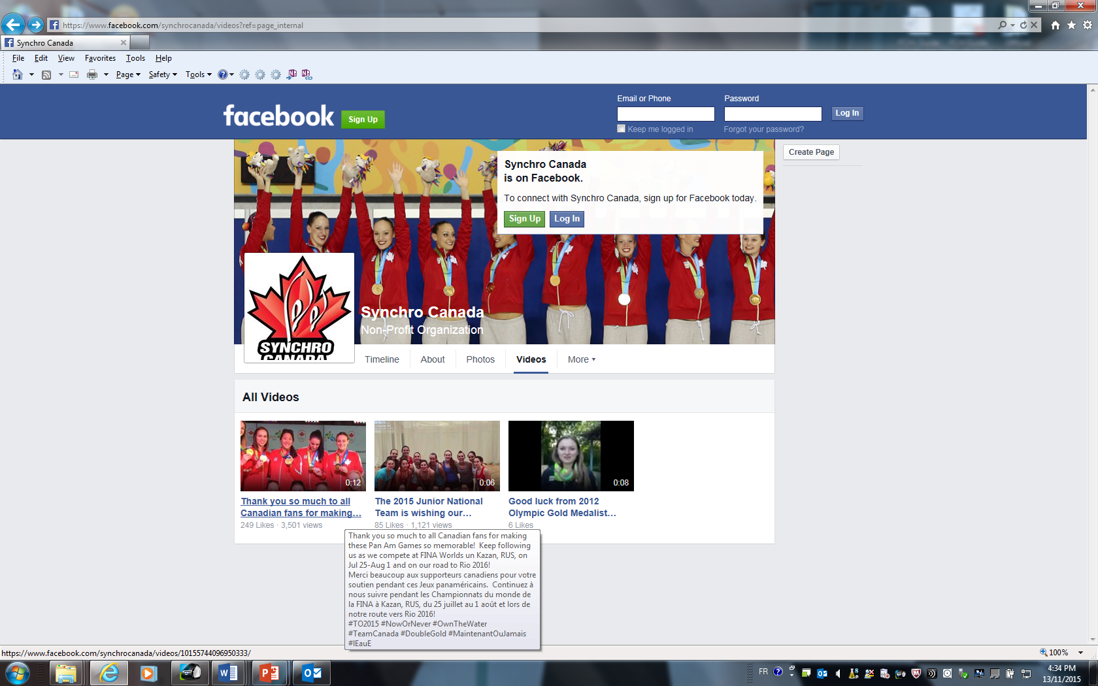
Level 5 - Robust
External content posted by the organization is available for all users regardless of the language used by the external source.
Example : Facebook page of Synchro Canada
https://www.facebook.com/synchrocanada/videos?ref=page_internal

Slide 32
Considerations
Using both official languages on social media extends your online reach.
Knowing the pre-existing social media conversation in English and French through popular and relevant hashtags also helps.
Connect with each other offline to share ideas and bilingual terminology to leverage each others content online. Strategic partnerships with like-minded organizations may have inroads into an audience segment for a particular project.

Slide 33
Reach out to Sport Canada!
Facebook | Facebook.com/SportCanadaEN Facebook.com/SportCanadaFR
Twitter | @SportCanada_EN @SportCanada_FR
Instagram | https://www.instagram.com/sportcanada/
YouTube | http://bit.ly/1Zcz2pP
Flickr | Flickr.com/SportCanada

Slide 34
5 Creative Ways to Integrate Official Languages on a Sport Organization Budget
Use templates for voicemail messages and email signature.
Make the best use of terminology data banks and lexicons (Multilingual).
Consider “Tips and Tricks” for cost-conscious translation.
Investigate alternative sources of funding support.
Use bilingual templates to maximize your communication reach through social media and minimize the costs.

Slide 35

Get in touch / Contactez-nous
Debra Gassewitz
President & CEO, SIRC
debrag@sirc.ca
sirc.ca
@SIRCTweets
@SIRCTweeter
Jaimie Earley
A. Manager, Official Languages, Sport Canada
Jaimie.earley@canada.ca

Slide 36
Resources / Ressources
Telephone bilingual “cheat sheet”
Voicemail scripts
Out of office scripts
Email signature block (bilingual)
Terminology online resources
Glossaries
Translation/Interpretation considerations
Online guides and more
http://sirc.ca/webinar/5-creative-ways-incorporate-official-languages-sport-organization-budget

Slide 37

Questions?

